Slide 1
Haemophilus influenzae type b Vaccines
Current as of 05/04/2020.
Notes:
I will provide a discussion of the epidemiology of Haemophilus influenzae type b disease as well as the vaccine recommendations for prevention of Hib disease.

Slide 2
About This Publication
This publication was designed to help prelicensure nursing faculty incorporate appropriate elements of the IRUN Curriculum Framework into their existing curricula. This content is also available in an accessible PDF file on the IRUN web page.
Please submit questions or comments about this publication via the IRUN web page.
This publication was funded by the Centers for Disease Control and Prevention (CDC) through Cooperative Agreement Number 5NU36OE000008-03-00 with the Association for Prevention Teaching and Research (APTR) and Cooperative Agreement Number 6NU36OE000009-02-01 with the American Association of Colleges of Nursing (AACN). Its contents are solely the responsibility of the authors and do not necessarily represent the official views of APTR, AACN, CDC, or the Department of Health and Human Services.

Slide 3
How to Use This Presentation
Users are free to make changes to the presentation to fit their needs, including adding, modifying, or removing content, graphics, and/or speaker’s notes.
Each presenter should review the presentation to ensure familiarity before delivering the content. Glossary word definitions should be incorporated into the following slides as needed.
DELETE THIS SLIDE BEFORE PRESENTATION

Slide 4
Glossary Overview
The following four slides define terminology used throughout the slides and speaker’s notes of this presentation.
Insert these definitions into the following slides and/or speaker’s notes as needed for your audience.
Alternatively, this glossary can be provided to the audience for review ahead of the presentation.
DELETE THIS SLIDE BEFORE PRESENTATION

Slide 5
Glossary
Aerobic bacteria: Those that grow in the presence of oxygen.
Antibody: A special protein made by the body in response to antigens (foreign substances such as bacteria or viruses). Antibodies bind with antigens on microorganisms to protect the body against infection.
Antipyretics: Fever-reducing medications.
Combination vaccine: A product containing components that can be divided equally into independently available vaccines.
Contraindication: A condition that increases the likelihood of a serious adverse reaction to a vaccine for a patient with that condition. If the vaccine is given in the presence of that condition, the resulting adverse reaction could seriously harm the recipient.
DELETE THIS SLIDE BEFORE PRESENTATION

Slide 6
Glossary (continued)
Gram-negative: Classification of bacteria with a cell wall composed of thin layers of peptidoglycan and an outer membrane with a lipopolysaccharide component not found in gram-positive bacteria. Stain red or pink during Gram staining.
Immunogenic: Ability of a substance to provoke an immune response.
Immunologic tolerance: State of immune unresponsiveness against a particular antigen that has the capacity to elicit an immune response. When immunologic tolerance is induced by the first dose of a vaccine, it reduces the body’s response to subsequent doses.
Inactivated vaccine: A vaccine in which the antigen is inactivated with heat and/or chemicals. The antigen in the vaccine is not alive and cannot replicate. These vaccines cannot cause disease from infection, even in an immunodeficient person. Inactivated vaccines always require multiple doses.
DELETE THIS SLIDE BEFORE PRESENTATION

Slide 7
Glossary (continued)
Incidence: The number of new disease cases reported in a population over a certain period of time.
Invasive disease (bacterial): Pathogens that are able to invade parts of the body where bacteria are not normally present (e.g., bloodstream, muscle, fat, etc.)
Live vaccine: A vaccine in which live antigen is weakened (attenuated) through chemical or physical processes to produce an immune response without causing the severe effects of the disease. Live vaccines currently licensed in the United States include measles-mumps-rubella, varicella, rotavirus, yellow fever, smallpox, and some formulations of influenza, shingles, and typhoid vaccines. Also known as an “attenuated vaccine.”
DELETE THIS SLIDE BEFORE PRESENTATION

Slide 8
Glossary (continued)
Precaution: A condition in a recipient that might increase the risk for a serious adverse reaction, might cause diagnostic confusion, or might compromise the ability of the vaccine to produce immunity.
Polysaccharide conjugate vaccine: Vaccine produced by chemically bonding a polysaccharide (a somewhat ineffective antigen) to a protein “carrier,” which is a more effective antigen. This process greatly improves immunogenicity, particularly in young children.
Respiratory droplet spread: Disease transmission that occurs when someone who has the bacteria in their nose or throat coughs or sneezes.
Serotype: Group within a single species of bacteria that share distinctive surface structures.
DELETE THIS SLIDE BEFORE PRESENTATION

Slide 9
Glossary (continued)
Simultaneous administration: Administering more than one vaccine on the same clinic day (at different anatomic sites and not combined in the same syringe).
Single-component vaccine: A vaccine that cannot be divided equally into independently available routine vaccines.
Vaccine effectiveness: A real-world view of how a vaccine reduces disease in a population. Often, a medicine that has a high efficacy rate in clinical trials is less effective in routine use.
Virulence: The relative capacity of a pathogen to overcome body defenses.
DELETE THIS SLIDE BEFORE PRESENTATION

Slide 10
Learning Objectives
Describe the etiologic agent, pathogenesis, signs and symptoms, and epidemiology of Haemophilus influenzae type b (Hib) disease.
Identify Hib vaccine indications, contraindications, and precautions.
Discuss the importance of appropriate spacing and timing of vaccine doses and benefits of simultaneous administration.
Describe correct vaccine and diluent storage and handling.
Define the steps for proper vaccine administration.
Explain the nurse’s role in preventing Hib disease through immunization.
Locate resources relevant to current Hib vaccine recommendations.
Notes:
Following today’s lecture, you will be able to meet these seven learning objectives. (READ SLIDE)

Slide 11
PUBLIC HEALTH PERSPECTIVE

Slide 12
Impact of Haemophilus influenzae type b Disease
Before the introduction of an effective Hib vaccine:
Hib disease was the leading cause of bacterial meningitis among children younger than 5 years of age.
Approximately 1 in 200 children younger than 5 years of age developed invasive Hib disease.
Nearly all Hib infections occurred among children younger than 5 years of age.
Approximately two-thirds of all cases occurred among children younger than 18 months of age.
Since licensure of conjugate Hib vaccines, incidence of invasive Hib disease has declined by more than 99%.
Information from Centers for Disease Control and Prevention. Epidemiology and Prevention of Vaccine-Preventable Diseases. Hamborsky J, Kroger A, Wolfe S, eds. 13th ed. Washington D.C. Public Health Foundation, 2015.
Notes:
Before the introduction of effective vaccines, H. influenzae type b, or Hib, was the leading cause of bacterial meningitis and other invasive bacterial disease among children younger than 5 years of age.
Approximately one in 200 children in this age group developed invasive Hib disease.
Nearly all Hib infections occurred among children younger than 5 years of age, and approximately two-thirds of all cases occurred among children younger than 18 months of age.
Since licensure of conjugate Hib vaccines, incidence of invasive Hib disease has declined by more than 99%.

Slide 13
Barriers to Vaccination: Health Care Access
Health insurance and poverty status are interrelated factors associated with lower vaccination coverage.
Children with Medicaid have low vaccination coverage, and those who are uninsured have much lower vaccination coverage.
Barriers to health care access:
Health insurance coverage
Poverty
Language barriers
Lack of trust in providers
Transportation problems
Inconvenient office hours
Information from Hill et al., 2017; Orenstein et al., 2014
Notes:
Health insurance and poverty status are interrelated factors associated with lower vaccination coverage in young children. Compared with children who had only private insurance, those with Medicaid had lower coverage and those who were uninsured had much lower coverage for most vaccines.
Children living below and up to a certain percentage above the poverty level are eligible for Medicaid (42.5% of 2016 NIS-Child population met the minimum Medicaid eligibility level of 138%) and are entitled to VFC vaccines.
Uninsured children, who account for 3.0% of the 2016 NIS-Child weighted sample, are eligible for the Vaccines for Children, or VFC, program, which was designed to increase access to vaccination among children through age 18 years who might not otherwise be vaccinated because of inability to pay. Some families might not be aware of the VFC program, might be unable to afford fees for visits to a vaccine provider, or might need assistance locating a physician who participates in the VFC program.
Barriers
Barriers to health care access and use among the publicly insured include language barriers, lack of trust in providers, transportation problems, inconvenient office hours, and other provider- and system-level factors.
Medicaid patients also tend to experience more breaks in insurance coverage than privately insured children do, and discontinuities in insurance coverage have been associated with lower vaccination coverage.
CDC has undertaken a number of activities designed to elucidate potential barriers to early childhood vaccination from the perspective of the state immunization programs and health care providers enrolled in the VFC program. There are also plans to assess parental experience with and barriers to accessing vaccination services.

Slide 14
IMMUNIZATION STRATEGIES

Slide 15
Strategies for High Vaccination Coverage
Reduce missed opportunities.
Schedule next immunization visit before patient leaves the office.
Utilize reminder and recall for patients.
Reduce barriers to immunization.
Information from Centers for Disease Control and Prevention. Epidemiology and Prevention of Vaccine-Preventable Diseases. Hamborsky J, Kroger A, Wolfe S, eds. 13th ed. Washington D.C. Public Health Foundation, 2015; Vaccination Coverage by Age 24 Months Among Children Born in 2015 and 2016—National Immunization Survey-Child, United States, MMWR/ October 18, 2019 / 68(41);913–918
Notes:
“Reducing missed opportunities” means establishing a policy to vaccinate at every visit if vaccinations are indicated. Providers need to use every patient encounter to screen for and offer vaccinations. An analysis of NIS-Child data for children born during 2005–2015 found that disparities in coverage with ≥4 doses of diphtheria, tetanus toxoids, and acellular pertussis vaccine (DTaP) for those with Medicaid compared with those with private health insurance could have been reduced by 42% if opportunities for receipt of the fourth DTaP dose had not been missed during visits when other vaccinations were received.
Another strategy to increase vaccination coverage is scheduling the next immunization visit before the patient leaves the office.
Reminder/recall systems are cost-effective methods to identify and notify families when children are due for vaccinations or are already behind. Reminders and recalls differ in content and can be delivered by telephone, text message, letter, postcard, or other methods. Most reminder and recall notices are tailored for individuals, and many include educational messages about the importance of vaccination.
Reducing barriers to immunization begins with recognizing the barriers, which include limited access to health care, competing provider priorities, low awareness of the benefits of vaccination, receipt of care from multiple providers, a complex vaccination schedule, and vaccine cost.

Slide 16
Strategies for High Vaccination Coverage
Provide recommendations and reinforcement.
Maintain thorough documentation in patient records.
Utilize Immunization Information Systems (IISs).
Information from Centers for Disease Control and Prevention. Epidemiology and Prevention of Vaccine-Preventable Diseases. Hamborsky J, Kroger A, Wolfe S, eds. 13th ed. Washington D.C. Public Health Foundation, 2015.
Notes:
Other strategies to achieve high vaccination coverage include recommending the vaccine and reinforcing this recommendation. This has been shown to be one of the most effective strategies for increasing vaccination coverage.
Another important strategy is good record-keeping through documentation including use of immunization information systems.

Slide 17
IMMUNE SYSTEM/IMMUNOLOGY

Slide 18
Haemophilus influenzae type b
Severe bacterial infection, particularly among infants
Aerobic gram-negative bacteria
6 different serotypes (a–f) of polysaccharide capsule
No vaccines to prevent disease caused by non-b-typeable or non-typeable strains
95% of invasive disease caused by type b (prevaccine era)
A culture plate growing H. influenzae bacteria.
Information from Centers for Disease Control and Prevention. Epidemiology and Prevention of Vaccine-Preventable Diseases. Hamborsky J, Kroger A, Wolfe S, eds. 13th ed. Washington D.C. Public Health Foundation, 2015. Image source: Centers for Disease Control and Prevention
Notes:
Haemophilus influenzae causes severe bacterial infections, particularly among infants. It is a Gram-negative bacterium. The encapsulated (typeable) strains have a polysaccharide capsule that is responsible for virulence and immunity. There are six different serotypes, and they are labeled types a through f. There are currently no vaccines to prevent disease caused by non-b-typeable or non-typeable strains. However, in the prevaccine era, type b organisms accounted for 95% of all strains that caused invasive disease.

Slide 19
VACCINE-PREVENTABLE DISEASES

Slide 20
Haemophilus influenzae type b Epidemiology
Reservoir | Human (asymptomatic carriers)
Transmission | Respiratory droplets presumed
Temporal pattern | Prevaccine: Peaked in September–December and March–May
Communicability | Generally limited but higher in some circumstances (e.g., household, child care)
Information from Centers for Disease Control and Prevention. Epidemiology and Prevention of Vaccine-Preventable Diseases. Hamborsky J, Kroger A, Wolfe S, eds. 13th ed. Washington D.C. Public Health Foundation, 2015.
Notes:
Humans are the only known reservoir, and carriers are asymptomatic. Hib does not survive in the environment on inanimate surfaces.
The primary mode of Hib transmission is presumably by respiratory droplet spread.
Several studies in the prevaccine era described a bimodal seasonal pattern in the U.S., with one peak during September through December and a second peak during March through May.
The contagious potential of invasive Hib disease is considered to be limited. However, certain circumstances, particularly close contact with an infected person (for example, in household, child care, or institutional settings) can lead to outbreaks or direct secondary transmission of the disease.

Slide 21
Haemophilus influenzae type b Clinical Manifestations
Meningitis
Most common clinical manifestation of invasive Hib disease
Almost a third of survivors are left with hearing impairment or other neurologic problems.
Case-fatality rate is 3% to 6% even with appropriate antimicrobial therapy.
Other invasive diseases caused by Hib
Epiglottitis
Pneumonia
Septic arthritis
Cellulitis
Information from Centers for Disease Control and Prevention. Epidemiology and Prevention of Vaccine-Preventable Diseases. Hamborsky J, Kroger A, Wolfe S, eds. 13th ed. Washington D.C. Public Health Foundation, 2015.
Notes:
Invasive disease caused by Hib can affect many organ systems. The most common types of invasive disease are meningitis, epiglottitis, pneumonia, arthritis, and cellulitis.
Meningitis is the most common clinical manifestation of invasive Hib disease, accounting for 50%–65% of cases in the prevaccine era. And 15 to 30% of survivors are left with hearing impairment or other neurologic problems. The case-fatality rate is 3%–6%, even with appropriate antimicrobial therapy.

Slide 22
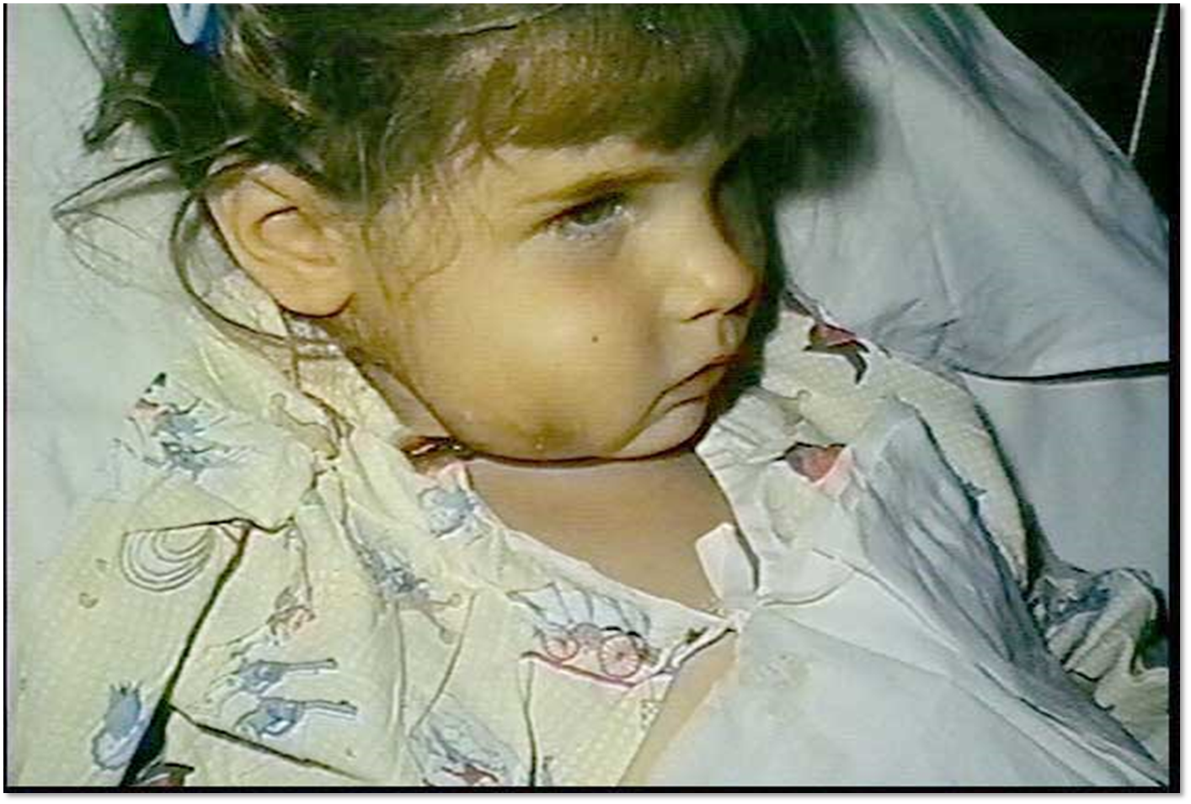
Facial cellulitis or infection of the soft tissues of the face caused by Hib
Image source: https://vaccineinformation.org/hib/photos.asp
Notes:
This picture shows a child with facial cellulitis or infection of the soft tissues of the face caused by Hib.

Slide 23
TYPE OF VACCINE

Slide 24
Type of Vaccine
Haemophilus influenzae type b (Hib) vaccines are inactivated vaccines.
Inactivated vaccines:
Cannot replicate
Require multiple doses before a protective antibody level is reached
May require booster doses
Two main groups:
Whole
Fractional
Information from Centers for Disease Control and Prevention. Epidemiology and Prevention of Vaccine-Preventable Diseases. Hamborsky J, Kroger A, Wolfe S, eds. 13th ed. Washington D.C. Public Health Foundation, 2015.
Notes:
Haemophilus influenzae type b (Hib) vaccines are inactivated vaccines.
The bacterium is inactivated with heat and/or chemicals such as formalin. Unlike live vaccines, inactivated vaccines cannot replicate or multiply. It is not possible for inactivated vaccines to result in infection from the antigen in the vaccine, even in immunodeficient people.
Since there is no replication, multiple doses are required to induce a protective antibody level. The immune response is primarily humoral, meaning consisting of antibodies. There is little, if any, cell-mediated immunity. The antibody titer or level will decline with time and periodic booster doses may be required.
There are two main groups of inactivated vaccines: those that contain inactivated whole virus or whole bacteria and a large second group called “fractional” vaccines. Fractional vaccines only contain the pieces of the organism that will induce an immune response. Among the fractional vaccines, most are protein-based, such as subunit vaccines and toxoids. Some fractional vaccines are polysaccharide-based and may be either pure polysaccharide or conjugated polysaccharide, meaning joined to a protein.

Slide 25
Haemophilus influenzae type b Vaccine
Inactivated, polysaccharide conjugate vaccine
Products include single-component and combination vaccines
Number of doses needed varies by product
Hib-containing products
Single component: ActHIB®, Hiberix®, and PedvaxHIB®
Combination: Pentacel® and Vaxelis®
Information from https://www.cdc.gov/vaccines/vpd/hib/hcp/about-vaccine.html
Notes:
FDA categorizes Hib vaccine as a polysaccharide conjugate vaccine, which is a type of inactivated vaccine. Manufacturers make it by joining a piece of the polysaccharide capsule that surrounds the Hib bacterium to a protein carrier. This joining process is called “conjugation.” Conjugating a protein carrier to a piece of the polysaccharide capsule from a Hib bacterium creates an effective vaccine. All of the vaccines are highly effective against Hib bacteria for people who receive a complete primary series. Three single-component Hib vaccines are currently licensed and available for use—ActHIB®, Hiberix®, and PedvaxHIB®. Pentacel® is a combination vaccine that includes Hib vaccine along with DTaP and polio vaccines. Vaxelis® is a combination vaccine that includes Hib vaccine along with DTaP, polio, and hepatitis B vaccines. These vaccines are licensed for use in infants as young as 6 weeks of age.

Slide 26
Immunogenicity and Vaccine Effectiveness
Hib vaccine is highly effective in producing immunity to Hib bacteria.
More than 95% of infants develop protective antibody levels after receiving a primary series of 2 or 3 doses.
Invasive Hib disease in a completely vaccinated infant is not common.
It is immunogenic in people with increased risk for invasive disease.
Although Hib vaccines provide long-lasting immunity, the exact duration of immunity is not known.
Information from https://www.cdc.gov/vaccines/vpd/hib/hcp/about-vaccine.html
Notes:
Hib conjugate vaccines are highly effective in producing immunity to Hib bacteria. More than 95% of infants develop protective antibody levels after receiving a primary series of 2 or 3 doses, depending on the product used. Invasive Hib disease in a completely vaccinated infant is uncommon. Hib vaccine is immunogenic in people with increased risk for invasive disease, including those with sickle cell disease, leukemia, HIV infection, and splenectomy.
Although Hib vaccines provide long-lasting immunity, the exact duration of immunity is not known.

Slide 27
IMMUNIZATION SCHEDULES

Slide 28
Advisory Committee on Immunization Practices (ACIP)
A group of medical and public health experts who develop recommendations on the use of vaccines in the civilian population of the United States
Provides guidance on use of vaccines and other biologic products to U.S. Department of Health and Human Services, CDC, and the U.S. Public Health Service
ACIP recommendations are standard of care in the U.S.
Information from Advisory Committee on Immunization Practices https://www.cdc.gov/vaccines/acip/committee/index.html
Notes:
The Advisory Committee on Immunization Practices (ACIP) is a group of medical and public health experts that develops recommendations on the use of vaccines in the civilian population of the United States. ACIP recommendations are considered standard of care in the U.S. The ACIP includes 15 voting members responsible for making vaccine recommendations. The recommendations stand as public health guidance for the safe use of vaccines and related biological products. The ACIP holds three meetings each year at the Centers for Disease Control and Prevention (CDC) headquarters in Atlanta, Georgia, to review scientific data and vote on vaccine recommendations. Meetings are open to the public and available online via live webcast.

Slide 29
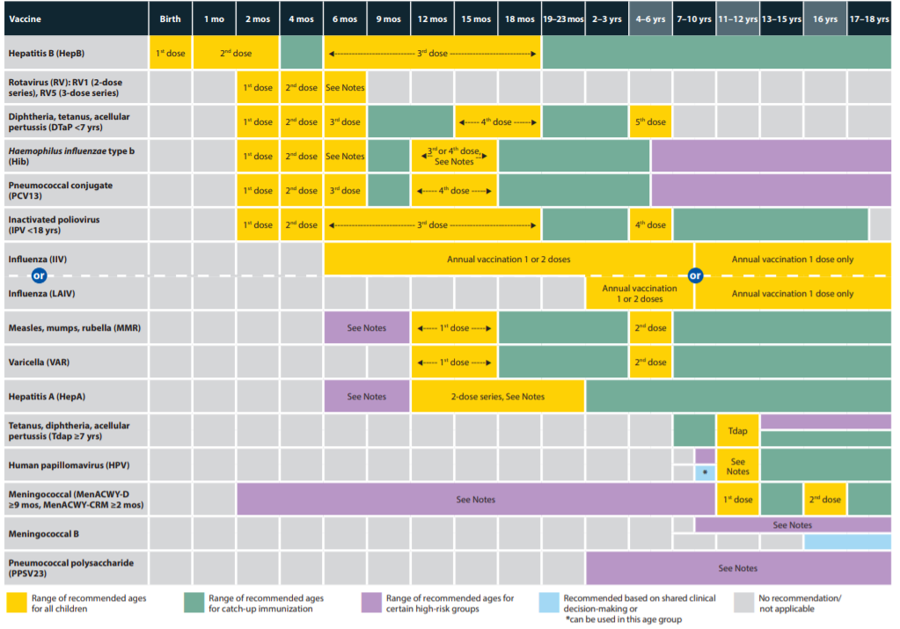
ACIP Hib Vaccine Recommendations: Pediatric
ACIP recommends Hib vaccine beginning at 2 months of age.
Routine pediatric recommendations are found in the Recommended Child and Adolescent Immunization Schedule for ages 18 years or younger.
Information from Centers for Disease Control and Prevention. Epidemiology and Prevention of Vaccine-Preventable Diseases. Hamborsky J, Kroger A, Wolfe S, eds. 13th ed. Washington D.C. Public Health Foundation, 2015; https://www.cdc.gov/vaccines/schedules/downloads/child/0-18yrs-child-combined-schedule.pdf.
Image source: www.cdc.gov/vaccines/schedules/hcp/imz/child-adolescent.html
Notes:
(READ SLIDE)

Slide 30
Vaccination Schedule by Product*
Vaccine Product | ACIP Abbreviation | 2 months of age | 4 months of age | 6 months of age | 12–15 months of age
ActHIB® | Hib (PRP-T) | X | X | X | X
Hiberix® | Hib (PRP-T) | X | X | X | X
PedvaxHIB® | Hib (PRP-OMP) | X | X |  | X
Pentacel® | DTaP-IPV/Hib | X | X | X | X**
Vaxelis® | DTaP-IPV-Hib-HepB | X | X | X
*Within a number range (e.g., 12–15), a dash (–) should be read as “through.”
**The recommended age for the 4th dose of Pentacel® is 15–18 months, but it can be given as early as 12 months, provided at least 6 months have elapsed since the 3rd dose.
Information from Centers for Disease Control and Prevention. Epidemiology and Prevention of Vaccine-Preventable Diseases. Hamborsky J, Kroger A, Wolfe S, eds. 13th ed. Washington D.C. Public Health Foundation, 2015.
Notes:
All infants, including those born preterm, should receive a primary series of conjugate Hib vaccine (single-component or combination vaccine), beginning at 2 months of age. The recommended interval between primary series doses is 8 weeks, with a minimum interval of 4 weeks. At least 8 weeks should separate the booster dose from the previous (second or third) dose. Hib vaccines may be given simultaneously with all other vaccines.
Limited data suggest that Hib conjugate vaccines given before 6 weeks of age may induce immunologic tolerance to subsequent doses of Hib vaccine. A dose given before 6 weeks of age may reduce the response to subsequent doses. As a result, Hib vaccines, including combination vaccines that contain Hib conjugate vaccine, should never be given to a child younger than 6 weeks of age.
The number of doses in the primary series depends on the type of vaccine used. A primary series of ActHIB®, Hiberix®, Pentacel®, or Vaxelis® requires 3 doses. The PedvaxHIB® vaccine series consists of 2 doses. A booster is recommended at 12 through 15 months regardless of which vaccine is used for the primary series.
At some ages, a child needs to receive several different recommended vaccines simultaneously. Manufacturers created combination vaccines to decrease the number of injections needed to give these recommended vaccines at the same time. There are two combination vaccines that contains Hib vaccine, Pentacel® and Vaxelis®. The recommended age for the fourth dose of Pentacel® is 15 through 18 months, but it can be given as early as 12 months, provided at least 6 months have elapsed since the third dose.

Slide 31
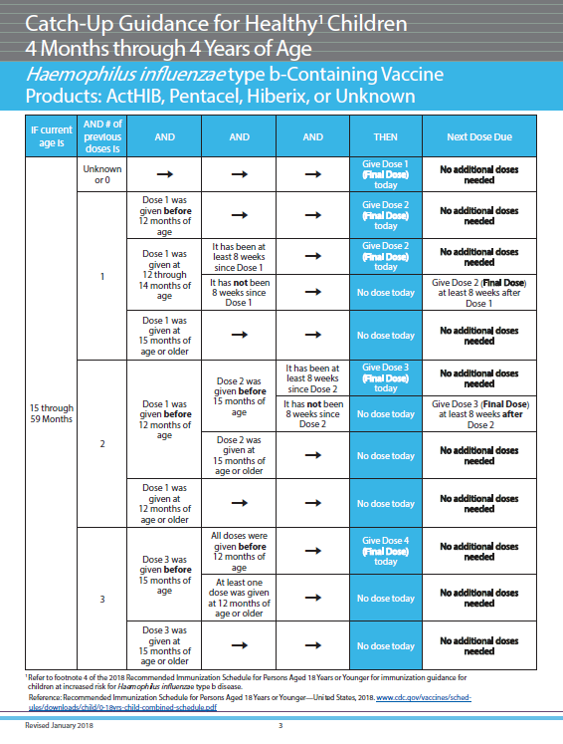
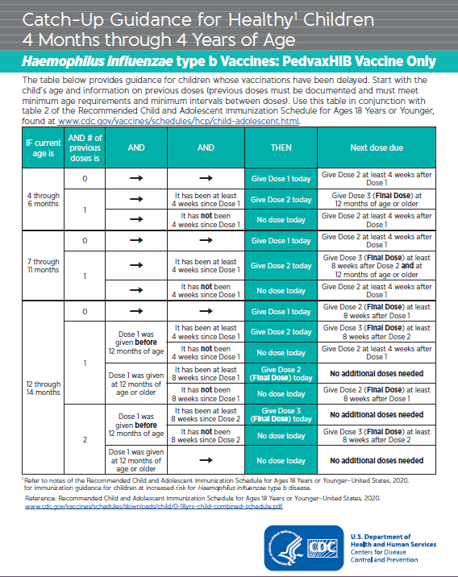
Unvaccinated Healthy Children 7 months of Age and Older
Children starting the Hib series late may not need the entire 3- or 4-dose series.
Number of doses child requires depends on current age and health status
CDC resources:
Catch-up schedule
Catch-up guidance for healthy children
Information from Centers for Disease Control and Prevention. Epidemiology and Prevention of Vaccine-Preventable Diseases. Hamborsky J, Kroger A, Wolfe S, eds. 13th ed. Washington D.C. Public Health Foundation, 2015; Catch-Up Guidance for Healthy Children 4 Months through 4 Years of Age www.cdc.gov/vaccines/schedules/downloads/child/job-aids/hib-actHib.pdf
Notes:
Unvaccinated children 7 months of age and older may not require a full series of 3 or 4 doses. The number of doses a child needs to complete the series depends on the child’s current age.
CDC resources are available that provide detailed guidance based on the age of the child and previous immunization history (valid doses only and other determining factors such as age at first dose). Because catch-up guidance can vary based on the product, there is one guidance chart for ActHIB®, Hiberix®, and Pentacel® and another for PedvaxHIB®.

Slide 32
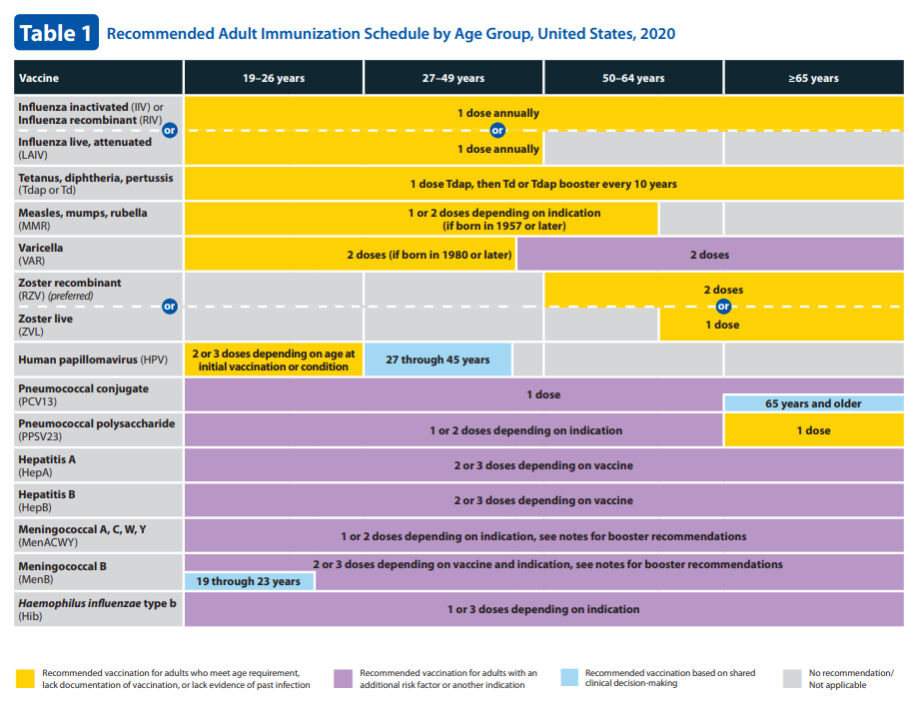
ACIP Hib Vaccine Recommendations: Adult
ACIP recommends Hib vaccine for adults at increased risk who were not vaccinated in childhood.
Information from www.cdc.gov/vaccines/schedules/hcp/imz/adult.html
Notes:
Hib immunization recommendations are included in both the childhood and adult immunization schedules. This slide shows the adult immunization schedule age-related figure. Again, Hib vaccine is highlighted by the red box.

Slide 33
ACIP Hib Immunization Recommendations: Older Children
Not recommended for healthy persons older than 59 months of age
Vaccinate high-risk older children, adolescents, and adults if incompletely vaccinated or previously unvaccinated, including those with:
Asplenia (anatomic and functional, including sickle cell disease)
IgG subclass/complement deficiency
Cancer requiring treatment with chemotherapy or radiation therapy
HIV infection
Bone marrow transplant recipients
Information from Centers for Disease Control and Prevention. Epidemiology and Prevention of Vaccine-Preventable Diseases. Hamborsky J, Kroger A, Wolfe S, eds. 13th ed. Washington D.C. Public Health Foundation, 2015.
Notes:
In general, Hib vaccination of healthy persons older than 59 months of age is not recommended. However, some older children who are at increased risk for invasive Hib disease may be vaccinated if they were not previously vaccinated in childhood or did not complete the series.
These include those with:
Functional or anatomic asplenia, including sickle cell disease (applies to children and adolescents)
IgG subclass/complement deficiency (applies to children only)
Cancer requiring treatment with chemotherapy or radiation therapy (applies to children only)
HIV infection (applies to children and adolescents through age 18 years)
Bone marrow transplant recipients (applies to children and adolescents). Doses of vaccine administered prior to transplant are NOT considered valid doses. All transplant recipients should be revaccinated with 3 doses of Hib vaccine 6 months posttransplant, regardless of the number of doses received prior to the transplant.

Slide 34
ACIP Hib Immunization Recommendations: Adults
Vaccinate high-risk adults if incompletely vaccinated or previously unvaccinated, including those with:
Asplenia (anatomic and functional, including sickle cell disease)
Bone marrow transplant recipients
Information from Centers for Disease Control and Prevention. Epidemiology and Prevention of Vaccine-Preventable Diseases. Hamborsky J, Kroger A, Wolfe S, eds. 13th ed. Washington D.C. Public Health Foundation, 2015.
Notes:
Some adults who are at increased risk for invasive Hib disease may be vaccinated if they were not previously vaccinated in childhood or did not complete the series. These include those with:
Functional or anatomic asplenia, including sickle cell disease
Bone marrow transplant recipients. Doses of vaccine administered prior to transplant are NOT considered valid doses. All transplant recipients should be revaccinated with 3 doses of Hib vaccine 6 months posttransplant, regardless of the number of doses received prior to the transplant.

Slide 35
ACIP Hib Immunization Recommendations: Special Populations
Children less than 24 months of age with invasive Hib disease
Administer complete series as recommended for child’s age.
Vaccinate during the convalescent phase of the illness.
Information from Centers for Disease Control and Prevention. Epidemiology and Prevention of Vaccine-Preventable Diseases. Hamborsky J, Kroger A, Wolfe S, eds. 13th ed. Washington D.C. Public Health Foundation, 2015.
Notes:
There are also specific recommendations for Hib vaccination in certain populations at increased risk of disease.
Hib invasive disease does not always result in development of protective antibody levels, so children younger than 24 months of age who develop invasive Hib disease should be considered susceptible and should receive a Hib vaccine series as recommended for their age at time of vaccination. Vaccination should start as soon as possible during the convalescent phase of the illness.

Slide 36
ACIP Hib Immunization Recommendations: Special Populations
American Indian/Alaska Natives
Hib disease peaks earlier in infancy.
PedVaxHIB® vaccine produces protective antibody after first dose (early protection).
PedVaxHIB® vaccine is specifically recommended for primary series doses.
Information from Centers for Disease Control and Prevention. Epidemiology and Prevention of Vaccine-Preventable Diseases. Hamborsky J, Kroger A, Wolfe S, eds. 13th ed. Washington D.C. Public Health Foundation, 2015.
Notes:
For American Indian/Alaska Native infants, Hib meningitis incidence peaks at a younger age. Because of this, PedvaxHIB® is the preferred vaccine for the primary series doses. PedvaxHIB® produces a protective antibody response after the first dose and provides early protection that American Indian/Alaska Native infants need.

Slide 37
Hib Vaccine Product Interchangeability
All single-component Hib vaccine products are interchangeable for primary series and booster dose.
Follow a 4-dose series if more than one brand of vaccine is used or if the product is not known for doses at 2 months and 4 months of age.
Whenever feasible, use same combination vaccine product for subsequent doses.
If vaccine used for earlier doses is not known or not available, any brand may be used to complete the series.
Information from Centers for Disease Control and Prevention. Epidemiology and Prevention of Vaccine-Preventable Diseases. Hamborsky J, Kroger A, Wolfe S, eds. 13th ed. Washington D.C. Public Health Foundation, 2015; Briere E, Rubin L, Moro P, Cohn A, Clark T, Messionnier, N. (2014). Prevention and control of Haemophilus influenzae type b disease: recommendations of the Advisory Committee on Immunization Practices (ACIP). MMWR Recomm Rep., 63(RR-01):1–14. PMID: 24572654
Notes:
The single-component Hib vaccines licensed for use in infants are interchangeable. If the vaccine product previously used is not available or is unknown, you can use one of the other brands. However, default to a 3-dose primary series (4 total doses) if it is a mixed product series.
Data on the interchangeability of combination vaccines with other combination vaccines or with monovalent vaccines are limited. For children who start the Hib series with a combination vaccine, the same combination vaccine should be used for the subsequent doses whenever feasible. If vaccine used for earlier doses is not known or not available, any brand may be used to complete the series. If a different brand is administered, the dose should be considered valid and does not need to be repeated.

Slide 38
COMMUNICATIONS

Slide 39
CDC Vaccine Information Statement (VIS)
Federal law requires that a VIS be provided to a patient, parent, or legal representative before each dose of certain vaccines.
VISs explain both the benefits and risks of the vaccine the patient is receiving.
Hib VIS
Information from Vaccine Information Statements www.cdc.gov/vaccines/hcp/vis/; Foreign language versions https://www.immunize.org/vis/
Notes:
All vaccine providers, public or private, are required by the National Vaccine Childhood Injury Act to give the appropriate VIS to the patient (or parent or legal representative) prior to every dose of certain vaccines. VISs have been translated into about 40 languages. These can be found on the website of CDC’s partner, the Immunization Action Coalition. There is a link at the bottom of this slide. Additional resources on the use of VISs are listed in the resources and references slides at the end of this presentation.

Slide 40
CDC Vaccine Information Statement (VIS)
How to provide a VIS prior to vaccination:
Printed and given to patients
Viewed on a computer monitor or other video display
Viewed on phone or other digital device
Printed and given during a prior visit or told how to access it through the internet in advance
Always offer the patient an opportunity to ask questions about the vaccine you are giving them.
The patient must be offered a copy of the VIS to take away following the vaccination. The patient may decline.
Information from https://www.cdc.gov/vaccines/hcp/vis/about/facts-vis.html
Notes:
There are a number of ways that a VIS can be provided prior to vaccination.
Paper copies of the VIS can be printed and given to patients.
Permanent, laminated office copies may be given to patients to read.
Patients may view VISs on a computer monitor or other video display.
Patients may read the VIS on their phone or other digital device by downloading the pdf file from CDC’s website.
Patients may be given a copy of a VIS during a prior visit, or told how to access it through the internet, so they can read it in advance. These patients must still be offered a copy to read during the immunization visit, as a reminder.
Always offer the patient an opportunity to ask questions about the vaccine you are giving them.
The patient must still be offered a copy of the VIS to take home. The patient may decline.

Slide 41
LEGAL/ETHICAL ISSUES

Slide 42
Legal and Ethical Considerations
State vaccination requirements
State laws establish vaccination requirements for child care and school entry.
Some states may also require immunization of health care personnel and of patients of health care facilities.
Information from https://www.cdc.gov/vaccines/imz-managers/laws/index.html
Notes:
(READ SLIDE)

Slide 43
Legal and Ethical Considerations
Vaccine exemptions
All states provide medical exemptions.
Some states offer religious and/or philosophical exemptions.
Some states require these exemptions be sworn or affirmed through signed, notarized affidavits.
Notwithstanding religious objections, children with vaccine exemptions may be excluded from child care facilities or school during an epidemic of any disease.
Information from https://www.cdc.gov/vaccines/imz-managers/laws/index.html
Notes:
(READ SLIDE)

Slide 44
Legal and Ethical Considerations
National Childhood Vaccine Injury Act (NCVIA)
Passed by Congress in 1986
Established VAERS to collect reports of vaccine adverse events
Initiated the National Vaccine Injury Compensation Program (VICP) to compensate individuals who experience certain health events following receipt of a VICP-covered vaccine
Information from https://www.cdc.gov/vaccines/imz-managers/laws/index.html
Notes:
Unsubstantiated vaccine injury claims caused a risk to the vaccine supply in the past because fear of lawsuits drove many manufacturers out of the vaccine business. In response, Congress passed the National Childhood Vaccine Injury Act in 1986. This law established the Vaccine Adverse Event Reporting System, which collects reports of vaccine adverse events, and includes a reporting table for the National Vaccine Injury Compensation Program. This program was also initiated by the law to compensate individuals who experience certain health events following vaccination. The VAERS reporting table complements the Health Resources and Services Administration Injury Table, outlining distinct outcomes that are compensable, along with the time period when the outcome occurred following vaccination.

Slide 45
Legal and Ethical Considerations
Consent for vaccines
There is no federal requirement for informed consent relating to immunization.
Individual states may have laws outlining consent requirements.
Health care systems/facilities also may have consent policies.
Information from https://www.cdc.gov/vaccines/imz-managers/laws/index.html
Notes:
(READ SLIDE)

Slide 46
VACCINE STORAGE AND HANDLING

Slide 47
Vaccine Storage and Handling
Preparation:
Prepare vaccine just prior to administration.
Follow specific reconstitution guidelines for ActHIB®, Hiberix®, Pentacel®, Vaxelis®, and PedvaxHib®.
Storage:
Refrigerate between 2°C–8°C (35°F–46°F).
Information from Centers for Disease Control and Prevention. Epidemiology and Prevention of Vaccine-Preventable Diseases. Hamborsky J, Kroger A, Wolfe S, eds. 13th ed. Washington D.C. Public Health Foundation, 2015; https://www.cdc.gov/vaccines/vpd/hib/hcp/storage-handling.html
Notes:
(READ SLIDE)

Slide 48
Vaccine Storage and Handling
Keys to vaccine storage
Reliable storage and temperature monitoring equipment
Accurate vaccine inventory management
Well-trained staff
“Keys to Storing and Handling Your Vaccine Supply” Video
Information from https://www2.cdc.gov/vaccines/ed/pinkbook/2019/downloads/PB5/SHVA_webinar_7-17-19.pdf
Notes:
Proper vaccine storage and handling are important factors in ensuring vaccine potency, thereby preventing many common vaccine-preventable diseases. Yet, each year, storage and handling errors result in revaccination of many patients and
significant financial loss due to wasted vaccines. Failure to store and handle vaccines properly can reduce vaccine potency, resulting in inadequate immune responses in patients and poor protection against disease. Patients can lose confidence in vaccines and providers if they require revaccination because the vaccines they received may have been compromised.
The following are necessary to protect a vaccine inventory:
Reliable storage and temperature monitoring equipment
Accurate vaccine inventory management
Well-trained staff
Additional resources on storage and handling are listed in the resources and references slides at the end of this presentation.

Slide 49
VACCINE ADMINISTRATION

Slide 50
Before Vaccine Administration
Assess for needed vaccines by reviewing the immunization history.
Accept only written, dated records.*
Compare to recommended vaccination schedule.
Screen for contraindications and precautions.
Discuss vaccine benefits, risks, and vaccine-preventable diseases using VISs and other reliable resources.
Provide after-care instructions.
*Self-reported doses of influenza and pneumococcal polysaccharide (PPSV23) vaccines are acceptable
Information from Centers for Disease Control and Prevention. Epidemiology and Prevention of Vaccine-Preventable Diseases. Hamborsky J, Kroger A, Wolfe S, eds. 13th ed. Washington D.C. Public Health Foundation, 2015.
Notes:
The patient’s immunization status should be reviewed at every health care visit. Using the patient's immunization history, health care personnel should assess for all routinely recommended vaccines, as well as any vaccines indicated based on health status, occupation, or other risk factors such as travel. Use the current immunization schedule based on the age of the patient to determine all vaccines that are needed.
The immunization history may be obtained by using information from immunization information systems, current and previous medical records, and personal vaccination record cards. Except for influenza and pneumococcal polysaccharide (PPSV23) vaccines, providers should only accept written, dated records as evidence of vaccination. Self-reported doses of influenza and PPSV23 vaccines are acceptable.
Before administering any vaccine, patients should be screened for contraindications and precautions, even if the patient has previously received that vaccine. The patient’s health status may change from one visit to the next or recommendations regarding contraindications and precautions may have changed. Using a standardized, comprehensive screening tool helps staff assess patients correctly and consistently. Staff should be knowledgeable about contraindications and precautions to vaccination and only valid contraindications should be followed.
Health care personnel should assess the level and type of information each patient or parent needs—for example, not everyone wants the same level of medical or scientific information about vaccines. Health care personnel need to be ready to answer questions. Fortunately, there are many resources available to help providers stay up to date on vaccine-related information, including vaccine information statements. Parent/patient education should also include a discussion of comfort and care strategies after vaccination. After-care instructions should include information for dealing with common side effects such as injection site pain, fever, and fussiness (especially in infants). After-care instructions should also include information on when to seek medical attention and when to notify the health care provider about any concerns that arise following vaccination.

Slide 51
Contraindications and Precautions
Screen for contraindications and precautions before administering vaccines:
Severe allergic reaction (anaphylaxis) to vaccine component or following a prior dose
Pentacel® only: Contraindications and precautions include those for the other component vaccines (DTaP, IPV, Hib)
Moderate or severe acute illness
Younger than 6 weeks of age
Note: Minor illnesses (e.g., mild upper respiratory infection) are not contraindications to vaccination.
Information from Centers for Disease Control and Prevention. Epidemiology and Prevention of Vaccine-Preventable Diseases. Hamborsky J, Kroger A, Wolfe S, eds. 13th ed. Washington D.C. Public Health Foundation, 2015.
Notes:
Patients and their family members count on health care personnel to administer vaccines safely. Screening helps prevent adverse reactions such as anaphylaxis.
Vaccination with Hib conjugate vaccine is contraindicated for persons who have experienced a severe allergic reaction (anaphylaxis) to a vaccine component or following a prior dose. For Pentacel®, this includes a severe allergic reaction to a previous dose of or to a component of DTaP or IPV vaccines.
Vaccination should be delayed for children with moderate or severe acute illnesses. But minor illnesses (e.g., mild upper respiratory infection) are not contraindications to vaccination. Hib conjugate vaccines are contraindicated for children younger than 6 weeks of age because of the potential for development of immunologic tolerance.
Additional resources for screening for vaccine contraindications and precautions are listed in the resources and references slides at the end of this presentation.

Slide 52
Vaccine Preparation
Handwashing.
Use designated, clean preparation area.
Prepare your own vaccines.
Prepare vaccine only when ready to administer.
Always follow the vaccine manufacturers’ directions, located in the package insert.
Check expiration date on the vaccine and diluent (if needed).
Information from Centers for Disease Control and Prevention. Epidemiology and Prevention of Vaccine-Preventable Diseases. Hamborsky J, Kroger A, Wolfe S, eds. 13th ed. Washington D.C. Public Health Foundation, 2015; https://www2.cdc.gov/vaccines/ed/vaxadmin/va/index.html
Notes:
Preparing vaccine properly is critical to maintaining the integrity of the vaccine during transfer from the manufacturer’s vial to the syringe and, ultimately, to the patient. CDC recommends preparing and drawing up vaccines just before administration. When preparing vaccines:
Follow strict aseptic medication preparation practices.
Perform hand hygiene BEFORE preparing vaccines.
Use a designated clean medication area that is not adjacent to any area where potentially contaminated items are placed.
Always follow the vaccine manufacturer’s directions, located in the package insert.
Some Hib vaccine products must be reconstituted. Only reconstitute lyophilized vaccines with the diluent provided by the manufacturer. Single-component ActHIB® diluent is a 0.4% sodium chloride solution. The diluent for Hiberix® is a 0.9% sodium chloride solution. Only reconstitute the ActHIB component in Pentacel with the DTaP-IPV liquid provided by the manufacturer. Once reconstituted, do NOT use if you cannot resuspend the reconstituted vaccine after thorough agitation.
Additional resources on vaccine preparation are listed in the resources and references slides at the end of this presentation.

Slide 53
Vaccine Administration Technique
Infants and toddlers best held in parent’s arms.
Children best held in parent’s lap
“Comfort and Restraint Techniques” Video
Information from Centers for Disease Control and Prevention. Epidemiology and Prevention of Vaccine-Preventable Diseases. Hamborsky J, Kroger A, Wolfe S, eds. 13th ed. Washington D.C. Public Health Foundation, 2015.
Notes:
Determine the best position and/or type of comforting restraint by considering the patient’s age, activity level, administration route and site, safety, and comfort. Parents and guardians play an important role when children receive vaccines. They can soothe and comfort the child, making them feel safe and secure. Parent participation has been shown to increase the child’s comfort and reduces the child’s perception of pain. Engage the parent or guardian in the process. Instruct parents/guardians to hold infants and children in a position comfortable for the child and parent, so that one or more limbs are exposed for injections. A parent’s embrace during vaccination offers several benefits.
A comforting hold:
Avoids frightening children by embracing them rather than overpowering them
Allows the health care provider steady control of the limb and the injection site
Prevents children from moving their arms and legs during injections
Encourages parents to nurture and comfort their child
While definitive guidelines for positioning patients during vaccination have not been established, some techniques have been suggested. Research shows that children age 3 years and older are less fearful and experience less pain when receiving an injection if they are sitting up rather than lying down. The exact mechanism behind this phenomenon is unknown. It may be that the child’s anxiety level is reduced, which, in turn, reduces the child’s perception of pain.

Slide 54
Vaccine Administration
Route
IM injection
Site
Younger than 12 months: Vastus lateralis (anterolateral thigh)
12 months and older:
Vastus lateralis (anterolateral thigh) preferred for persons age 1–2 years old
Deltoid muscle of arm preferred for persons age 3 years and older
Information from https://www2a.cdc.gov/nip/isd/ycts/mod1/courses/hib/index.html; Image source: Adapted from California Immunization Branch.
Notes:
Always administer Hib-containing vaccines by the intramuscular route.
The proper injection site should be determined based on age and appropriate technique. In infants and children younger than 3 years of age, the vastus lateralis muscle is the preferred site. In persons age 3 years and older, the deltoid muscle is the preferred site. Insert the needle at a 90-degree angle. The muscle can be flattened or bunched up.
Additional resources on administering IM injections are listed in the resources and references slides at the end of this presentation.

Slide 55
Vaccine Administration
Needle Size:
22–25 gauge
Children: 5/8- to 1-inch
Adults: 1–1.5-inches
Use clinical judgment when selecting needle length. Needle selection should be based on the route, age, gender and weight for adults (19 years and older), site, and injection technique.
Information from https://www2a.cdc.gov/nip/isd/ycts/mod1/courses/hib/index.html
Notes:
Although there are several Hib vaccines, the recommended dose for all is 0.5 mL. Select a needle that is 22- through 25-gauge. Use clinical judgment when selecting needle length. Vaccines must reach the desired tissue for an optimal immune response and to reduce the likelihood of injection site reactions. Therefore, when choosing needle length, select a needle long enough to reach the muscle tissue but not so long as to reach any underlying bone, nerves, or blood vessels. Use a needle length appropriate for the patient’s age, gender, weight (for adults), and site, as well as the injection technique that will be used.

Slide 56
DOCUMENTATION

Slide 57
Documenting Vaccinations
All vaccinations should be documented in the patient’s permanent medical record. Federal law requires documentation of:
Vaccine manufacturer
Vaccine lot number
Date of administration
Name and title of the person who administered the vaccine and the address of the facility where the permanent record will reside
Edition date of the vaccine information statement and the date it was provided to the patient, parent, or legal guardian
Information from Centers for Disease Control and Prevention. Epidemiology and Prevention of Vaccine-Preventable Diseases. Hamborsky J, Kroger A, Wolfe S, eds. 13th ed. Washington D.C. Public Health Foundation, 2015.
Notes:
Accurate and timely documentation can help prevent administration errors and curtail the number and cost of excess vaccine doses administered. In addition, preventing excess doses of vaccines may decrease the number of adverse reactions. All vaccines administered should be fully documented in the patient’s permanent medical record. Health care providers who administer vaccines covered by the National Vaccine Injury Compensation Program are required to document the following information in the patient’s permanent record:
Vaccine manufacturer
Vaccine lot number
Date of administration
Name and title of the person who administered the vaccine and the address of the facility where the permanent record will reside
Edition date of the VIS distributed and the date provided
This federal law applies to all routinely recommended childhood vaccines, even for doses of the vaccine that are administered to adults. The law applies to the on-point provider, who is not liable for previous lack of documentation. For influenza and PPSV23 vaccines, a provider is allowed to document self-reported doses. They are not liable if the report is wrong.
Additional resources for documenting vaccinations after administration are listed in the resources and references slides at the end of this presentation.

Slide 58
Documentation: Best Practice Guidelines
Best practice guidelines also include documenting:
Route
Dosage (amount)
Site
Expiration date
Provide personal immunization record that includes the vaccinations and administration dates.
Update medical records to include:
Adverse events after vaccination
Serologic test results related to vaccine-preventable diseases (e.g., those for rubella screening and antibody to hepatitis B surface antigen)
Information from Centers for Disease Control and Prevention. Epidemiology and Prevention of Vaccine-Preventable Diseases. Hamborsky J, Kroger A, Wolfe S, eds. 13th ed. Washington D.C. Public Health Foundation, 2015; https://www2.cdc.gov/vaccines/ed/vaxadmin/va/index.html
Notes:
Medication administration best practices also include documenting the route, dosage (amount), site, and vaccine expiration date. The patient or parent/guardian should be provided with a personal immunization record that includes the vaccinations and date administered. Providers should update patients’ permanent medical records to reflect any documented episodes of adverse events after vaccination and any serologic test results related to vaccine-preventable diseases (e.g., those for rubella screening and antibody to hepatitis B surface antigen).

Slide 59
Reporting Vaccine Adverse Events
Vaccine Adverse Event Reporting System (VAERS): A passive surveillance system to monitor adverse events following vaccination
Health care providers are required by law to report:
Any adverse event listed by the vaccine manufacturer as a contraindication to further doses of the vaccine
Any adverse event listed in the VAERS Table of Reportable Events Following Vaccination that occurs within the specified time period after vaccination
Health care providers are encouraged to report:
Any adverse event after the administration of a vaccine
Vaccine administration errors
Information from https://vaers.hhs.gov/reportevent.html
Notes:
Severe, life-threatening anaphylactic reactions following vaccination are rare.
Report significant adverse events that occur after vaccination of adults and children, even if you are not sure whether the vaccine caused the adverse event.
VAERS accepts all reports, including reports of vaccine administration errors.
Health care professionals are required to report:
Any adverse event listed by the vaccine manufacturer as a contraindication to further doses of the vaccine
Any adverse event listed in the VAERS Table of Reportable Events Following Vaccination within the specified time period

Slide 60
Reporting Adverse Events
VAERS Table of Reportable Events Following Vaccination
Vaccine/Toxoid | Event and Interval from Vaccination
Haemophilus influenzae type b in any combination (conjugate): Hib, Hib-HepB, DTaP-IPV/Hib, Hib-MenCY | A. Shoulder injury related to vaccine administration (7 days) B. Vasovagal syncope (7 days) C. Any acute complication or sequelae (including death) of above events (interval not applicable) D. Events described in manufacturer’s package insert as contraindications to additional doses of vaccine
Information from https://vaers.hhs.gov/docs/VAERS_Table_of_Reportable_Events_Following_Vaccination.pdf
Notes:
Providers should report all adverse events after vaccination to VAERS. This table reflects conditions reportable by law, but providers should report any adverse event that concerns them.

Slide 61
VACCINE SAFETY

Slide 62
Hib Vaccine Adverse Reactions
Swelling, redness, or pain at the injection site
Systemic reactions infrequent
Serious adverse reactions rare
Information from Centers for Disease Control and Prevention. Epidemiology and Prevention of Vaccine-Preventable Diseases. Hamborsky J, Kroger A, Wolfe S, eds. 13th ed. Washington D.C. Public Health Foundation, 2015.
Notes:
The most common adverse reactions following Hib vaccine include local reactions such as swelling, redness, or pain. These reactions have been reported in 5% to 30% of recipients.
Systemic reactions such as fever and irritability are infrequent, and serious adverse reactions are rare.

Slide 63
NURSING CONSIDERATIONS

Slide 64
Nursing Considerations
Supportive Treatment
 | Mild to moderate reaction | Severe reaction (anaphylaxis)
Reactions | Soreness, redness, itching, swelling | Hoarseness, wheezing, airway constriction, difficulty breathing, pale or mottled skin, hypotension, altered mental status, fever, redness, rash
Treatment | Cool, damp cloth to help reduce redness, soreness, and/or swelling at the injection site, antipyretics can be used for fever and local discomfort following vaccination | Call 911, administer CPR, provide epinephrine or equivalent (e.g., EpiPen), immediate transfer to hospital, if appropriate
Information from Centers for Disease Control and Prevention. Epidemiology and Prevention of Vaccine-Preventable Diseases. Hamborsky J, Kroger A, Wolfe S, eds. 13th ed. Washington D.C. Public Health Foundation, 2015; https://www.cdc.gov/vaccines/parents/by-age/months-1-2.html
Notes:
Supportive Treatment
Mild to moderate reaction
Reactions: Soreness, redness, itching, swelling
Treatment: Cool, damp cloth to help reduce redness, soreness, and/or swelling at the injection site. Evidence does not support use of antipyretics before or at the time of vaccination. However, they can be used for the treatment of fever and local discomfort that might occur following vaccination.
Severe reaction (anaphylaxis)
Severe, life-threatening anaphylactic reactions following vaccination are rare. Staff must have in place and be familiar with procedures for managing a severe reaction. Staff should be familiar with the signs and symptoms of anaphylaxis, which usually begin within minutes of vaccination.
These signs and symptoms can include, but are not limited to, flushing, facial edema, urticaria, itching, swelling of the mouth or throat, wheezing, and difficulty breathing. Each staff member should know their role in the event of an emergency and all vaccination providers should be certified in cardiopulmonary resuscitation (CPR).
Epinephrine and equipment for maintaining an airway should be available for immediate use. After the patient is stabilized, arrangements should be made for immediate transfer to an emergency facility for additional evaluation and treatment.

Slide 65
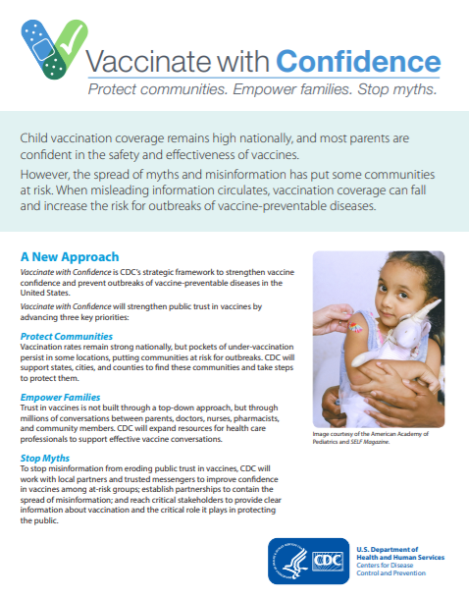
Nursing Considerations
Vaccinate with Confidence
CDC’s strategic framework to strengthen vaccine confidence and prevent outbreaks of vaccine-preventable diseases in the United States
Key priorities:
Protect communities.
Empower families.
Stop myths.
Vaccinate with Confidence fact sheet
Information from https://www.cdc.gov/vaccines/partners/vaccinate-with-confidence.html
Notes:
Vaccinate with Confidence is CDC’s strategic framework to strengthen vaccine confidence and prevent outbreaks of vaccine-preventable diseases in the United States. This slide contains links to the Vaccinate with Confidence web page and fact sheet.
Vaccinate with Confidence will strengthen public trust in vaccines by advancing three key priorities:
Protect communities.
Empower families.
Stop myths.
Protect communities: Vaccination coverage remains strong nationally, but pockets of undervaccination persist in some locations, putting communities at risk for outbreaks. CDC will support states, cities, and counties to find these communities and take steps to protect them.
Empower families: Trust in vaccines is not built through a top-down approach, but through millions of conversations between parents, doctors, nurses, pharmacists, and community members. CDC will expand resources for health care professionals to support effective vaccine conversations.
Stop myths: To stop misinformation from eroding public trust in vaccines, CDC will work with local partners and trusted messengers to improve confidence in vaccines among at-risk groups, establish partnerships to contain the spread of misinformation, and reach critical stakeholders to provide clear information about vaccination and the critical role it plays in protecting the public.

Slide 66
Immunization Information Systems (IISs)
IISs are confidential, computerized databases that record all vaccine doses administered by providers to persons residing within a given geopolitical area.
IISs provide consolidated immunization histories that help in determining appropriate client vaccinations.
All immunization providers are encouraged to document all administered vaccines in an IIS.
Information from Centers for Disease Control and Prevention. Epidemiology and Prevention of Vaccine-Preventable Diseases. Hamborsky J, Kroger A, Wolfe S, eds. 13th ed. Washington D.C. Public Health Foundation, 2015.; About Immunization Information Systems https://www.cdc.gov/vaccines/programs/iis/about.html; https://www.cdc.gov/vaccinesafety/concerns/history/gardasil-recall-faq.html
Notes:
By 2 years of age, over 20% of the children in the U.S. typically have seen more than one health care provider, resulting in scattered medical records. Immunization information systems (IISs) help providers and families by consolidating immunization information into one reliable source. IISs are confidential, population-based, computerized information systems that collect and consolidate vaccination data from multiple health care providers within a geographic area. Immunization providers are strongly encouraged to participate in an IIS. Laws on using an IIS vary by state or region. Some states mandate use of an IIS to document vaccinations for certain populations. Providers should be aware of state and/or regional requirements for reporting.

Slide 67
Vaccine Resources and References
Notes:
A list of vaccine resources and references follows.

Slide 68
Vaccine Resources and References
ACIP recommendations
Current ACIP Haemophilus influenzae type b vaccine recommendations www.cdc.gov/vaccines/hcp/acip-recs/vacc-specific/hib.html
ACIP General Best Practice Guidelines for Immunization www.cdc.gov/vaccines/hcp/acip-recs/general-recs/index.html
Disease
CDC Haemophilus influenzae type b disease webpage www.cdc.gov/hi-disease/clinicians.html
Hib Disease Information You Need to Know www.chop.edu/conditions-diseases/haemophilus-influenzae-infections

Slide 69
Vaccine Resources and References
Manufacturer’s vaccine package inserts (PIs)
PedvaxHIB®, Merck & Co., Inc. www.fda.gov/BiologicsBloodVaccines/Vaccines/ApprovedProducts/ucm094051.htm
Pentacel®, Sanofi Pasteur www.fda.gov/downloads/BiologicsBloodVaccines/Vaccines/ApprovedProducts/UCM109810.pdf
ActHIB®, Sanofi Pasteur www.fda.gov/downloads/BiologicsBloodVaccines/Vaccines/ApprovedProducts/UCM109841.pdf
Hiberix®, GlaxoSmithKline www.fda.gov/biologicsbloodvaccines/vaccines/approvedproducts/ucm179527.htm
Vaxelis® , MSP Vaccine Company
https://www.fda.gov/vaccines-blood-biologics/vaxelis

Slide 70
Vaccine Resources and References
Immunization schedules
Recommended Child and Adolescent Immunization Schedule for ages 18 years or younger https://www.cdc.gov/vaccines/schedules/hcp/imz/child-adolescent.html#birth-15
Catch-up Immunization Schedule https://www.cdc.gov/vaccines/schedules/hcp/imz/catchup.html
Catch-Up Guidance for Healthy Children 4 Months through 4 Years of Age https://www.cdc.gov/vaccines/schedules/downloads/child/job-aids/hib-actHib.pdf

Slide 71
Vaccine Resources and References
Communications
Current vaccine information statements (VISs) https://www.cdc.gov/vaccines/hcp/vis/current-vis.html
Instructions for Using VISs https://www.cdc.gov/vaccines/hcp/vis/about/required-use-instructions.html
Translated VISs https://www.immunize.org/vis/?f=9
Vaccine storage and handling
Vaccine Storage and Handling Toolkit https://www.cdc.gov/vaccines/hcp/admin/storage/toolkit/index.html
“Keys to Storing and Handling Your Vaccine Supply” https://www.youtube.com/watch?v=VCzO8Zod8DI

Slide 72
Vaccine Resources and References
Vaccine administration
Immunization Action Coalition Clinic Tools Screening for Vaccine Contraindications and Precautions https://www.immunize.org/clinic/screening-contraindications.asp
CDC Vaccine Administration Resource Library https://www.cdc.gov/vaccines/hcp/admin/resource-library.html
Documentation
Documentation of Vaccinations After Administration https://www.youtube.com/watch?v=xlyqUgKGFPk

